Slide 1
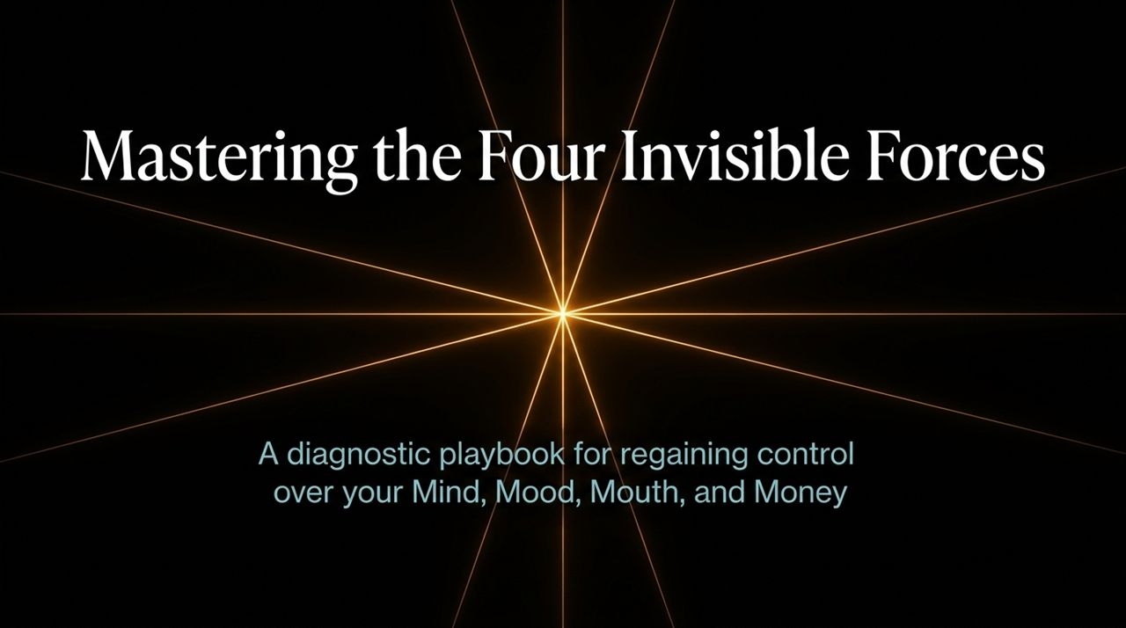
Notes:
Introduction & Frame: Welcome, everyone. Today we are exploring a fundamental truth that governs our lives: Big lives are rarely destroyed by one massive, dramatic mistake. Instead, they are quietly weakened by small permissions—invisible choices made day in and day out.
The Core Thesis: We live in a world obsessed with external circumstances—the economy, market changes, other people's actions. But real control isn't about governing the entire world. It’s about governing your internal territory: your Mind, Mood, Mouth, and Money.
Video Reference & Context: In the keynote video, the speaker emphasizes that intelligence, talent, and education cannot save you if these four domains are out of alignment. You can have all the potential in the world, yet watch your life move slowly in the wrong direction simply because these forces are controlling you instead of you controlling them.
https://www.youtube.com/watch?v=lLwChnl_fXQ

Slide 2
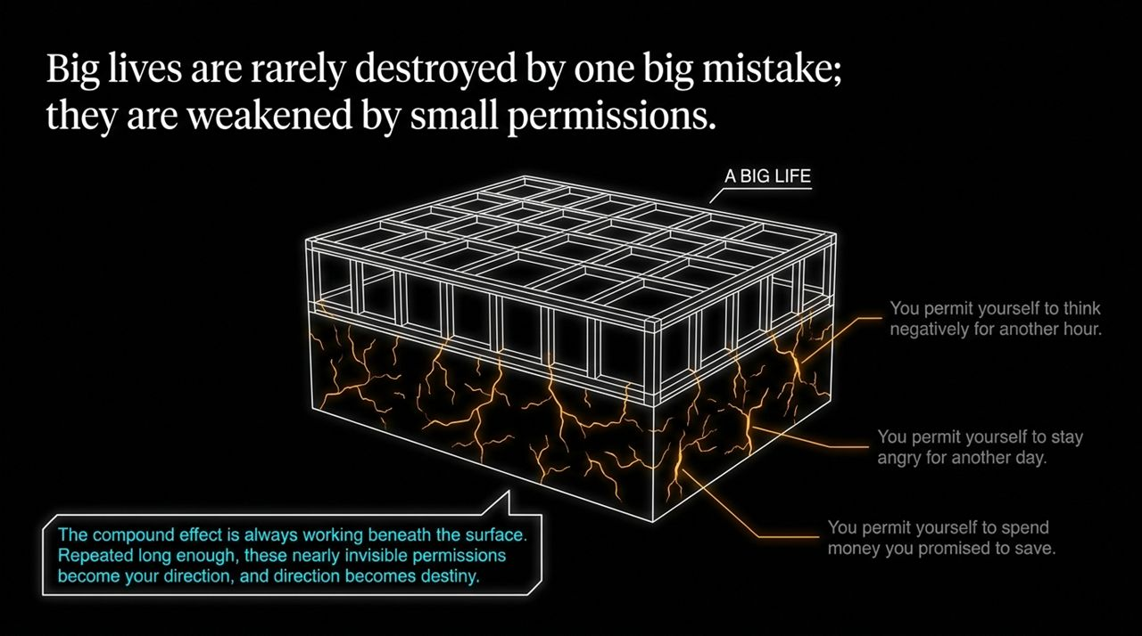
Notes:
The Danger of 'Small Permissions': Notice the graphic on this slide. You permit yourself to think negatively for another hour. You permit yourself to stay angry for another day. You permit yourself to spend money you promised you would save.
The Invisible Mechanism: Why are these small permissions so dangerous? Because nothing dramatic happens immediately. If you plant a seed today, you don't see a tree tomorrow. But beneath the surface, the compound effect is always running.
Video Insights: As noted in the talk, repeated long enough, these nearly invisible permissions become your direction, and direction inevitably becomes your destiny. The mind plants, the mood waters, the mouth reinforces, and the money reveals your true values. Years later, people call the outcome 'luck' or 'destiny,' but it was built in these quiet, private moments.
Key Audience Question: What is one small permission you’ve been granting yourself this week that you know is steering you off course?

Slide 3
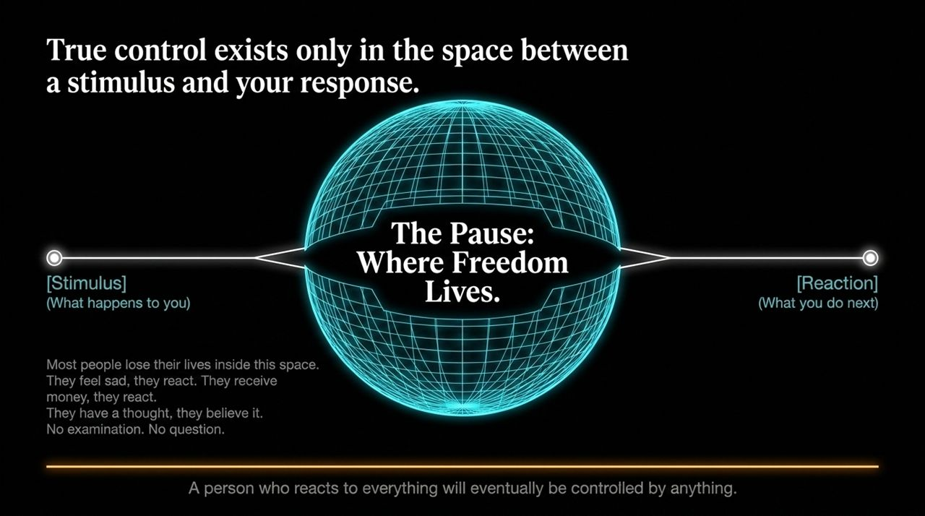
Notes:
Deconstructing Reaction: Look at the visual flow: Stimulus leads to Reaction. Most people live entirely trapped iide that direct arrow. Something happens $→$they react. They get criticized $→$they get angry. They receive money $→$they spend it. They have a thought $→$they believe it as absolute truth.
The Power of the Pause: Freedom lives in the space between stimulus and response. A person who reacts to everything will eventually be controlled by anything.
Video Reference: The speaker notes that if another person's words can instantly trigger anger or ruin your afternoon, that person holds a remote control to your emotions. Control isn't becoming emotionless; it's building the mental discipline to pause, examine, and choose your next action intentionally.

Slide 4
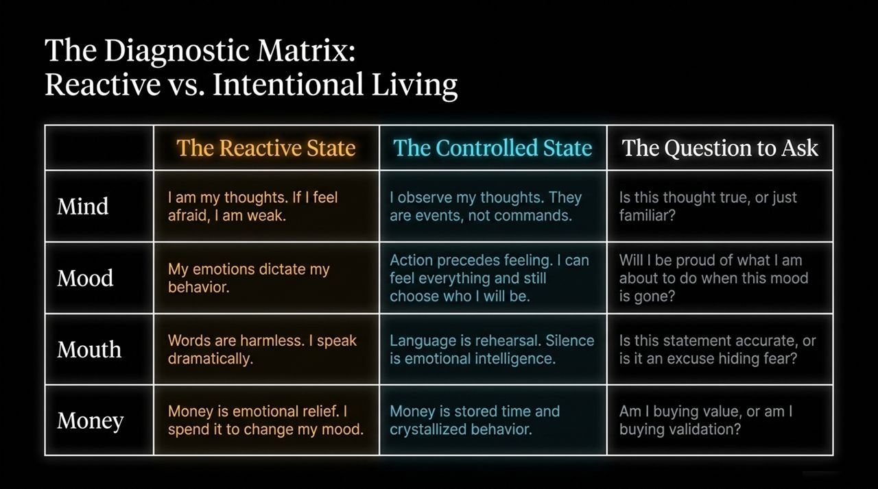
Notes:
Walking Through the Matrix: This diagnostic matrix is our compass today. Let's compare how a reactive person operates versus how a controlled person operates across all 4 M's:
Mind: Reactive says 'I am my thoughts', while Controlled realizes 'I observe my thoughts; they are events, not commands'.
Mood: Reactive lets feelings dictate behavior. Controlled understands that action precedes feeling—you take the walk before you feel like walking.
Mouth: Reactive speaks dramatically and uses language carelessly. Controlled uses language accurately and recognizes silence as emotional intelligence.
Money: Reactive uses money for temporary emotional relief. Controlled sees money as stored time and disciplined behavior.
Key Message: Always ask the diagnostic questions: Is this thought true, or just familiar? Will I be proud of what I am about to do when this mood passes? Am I buying value, or buying validation?

Slide 5
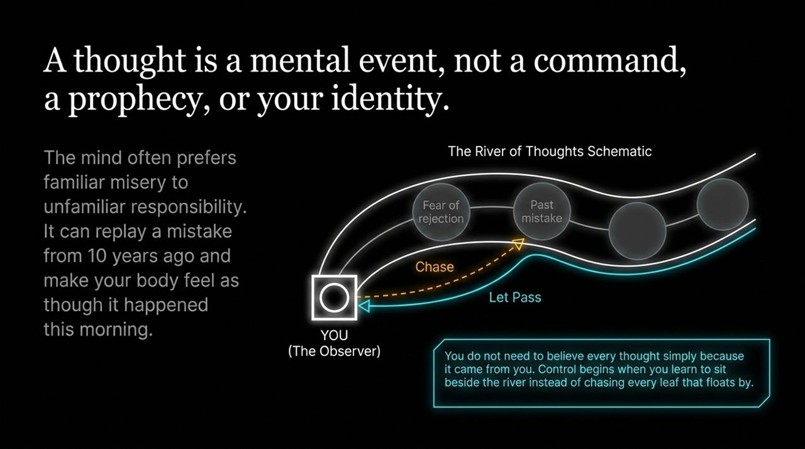
Notes:
Explaining the Visual: On this slide, imagine sitting on the bank of a river. Floating down the stream are thoughts—fear of rejection, past mistakes, anxiety, doubts.
Chasing vs. Letting Pass: What does the reactive person do? They jump into the cold water and chase every single leaf that floats by. They replay a mistake from 10 years ago and force their physical body to experience the stress all over again as if it happened this morning.

Slide 6
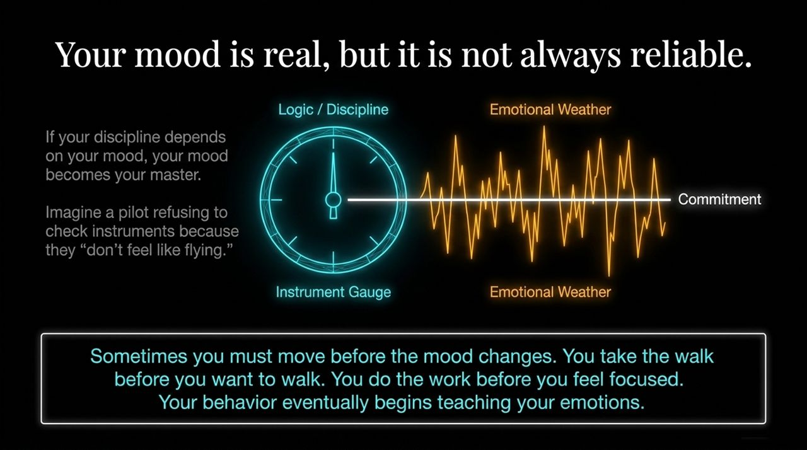
Notes:
The Pilot Metaphor: Your mood is real, but it is not always reliable. Imagine a pilot flying a commercial plane through thick fog and storm clouds, refusing to look at the instrument gauge because they 'don't feel like flying today'. That would be catastrophic.
Disciplined Action: Yet, many people manage their career, health, and finances based strictly on 'emotional weather'. If they feel motivated, they work; if they feel low, they quit.

Slide 7
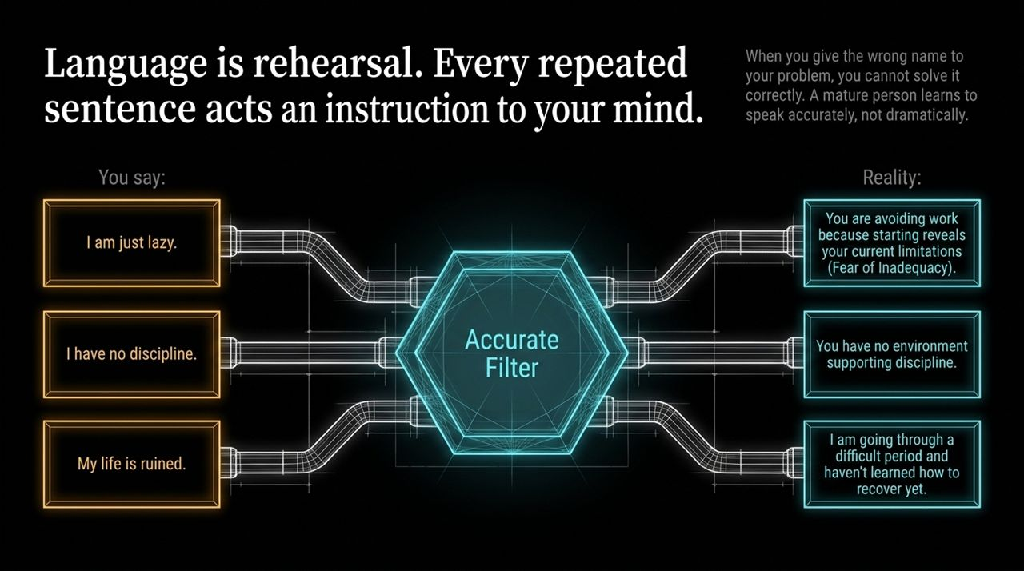
Notes:
The Concept: Language is rehearsal. Every time you speak, you give your subconscious mind an instruction.
Analyzing the Filter:
When you say I am just lazy, the Accurate Filter reveals: You are avoiding work because starting exposes your fear of inadequacy
When you say I have no discipline, the reality is: You haven't designed an environment that supports discipline.
When you say My life is ruined, the accurate truth is: I am going through a difficult period and learning how to recover.

Slide 8
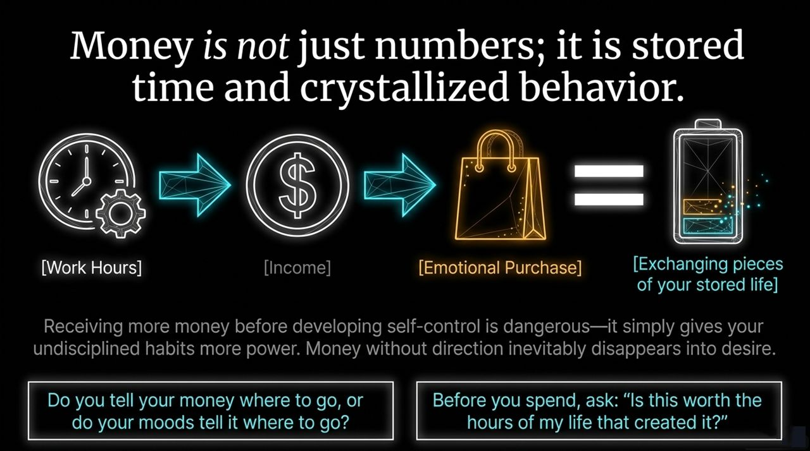
Notes:
Redefining Money: Money isn't just digits on an app screen. Money represents your life hours. You trade hours of your finite life for income.
The Emotional Spend Cycle: When you make an impulse purchase for temporary validation or to fix a bad mood, you are literally trading away pieces of your stored life.

Slide 9
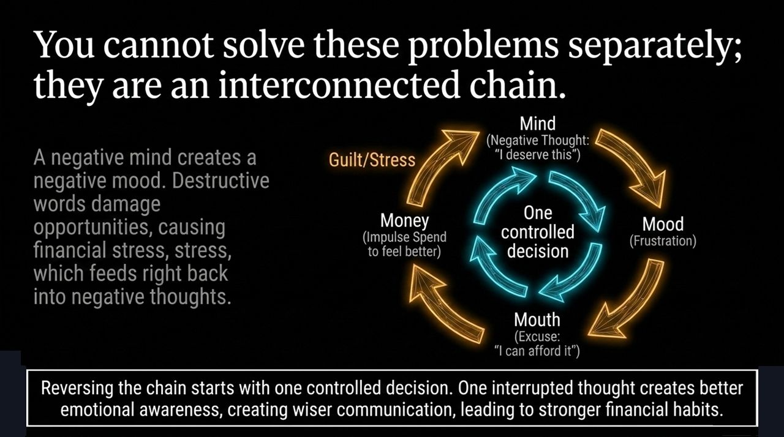
Notes:
The Negative Feedback Loop: The 4 M's do not exist in isolation; they are deeply linked. A negative Mind ('I deserve a reward') leads to a frustrated Mood. That mood drives the Mouth to make excuses ('I can afford it'). That leads to impulse spending (Money), which results in debt, guilt, and stress, feeding right back into a negative Mind.
Breaking the Loop: The good news is that this chain works both ways. You don't need to fix everything at once—one controlled decision interrupts the entire destructive cycle. One paused thought yields emotional clarity, wiser speech, and grounded financial habits.

Slide 10
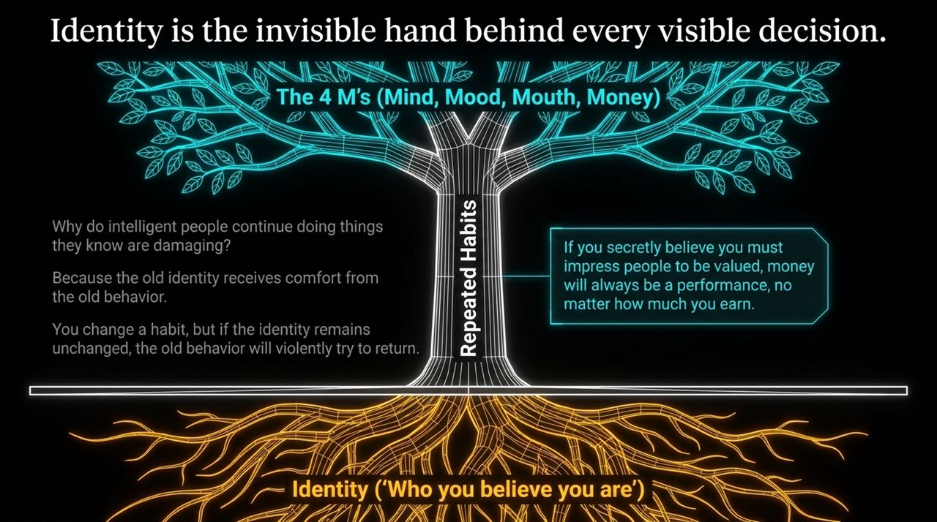
Notes:
Why Habit Changes Fail: Why do intelligent people continuously do things they know are bad for them? Because their old identity derives comfort from the old behavior.
The Root System: Look at the slide graphic showing roots beneath the surface. Your repeated habits are supported by your internal identity. If you change a habit without transforming your underlying belief about who you are, the old identity will aggressively pull you back.

Slide 11
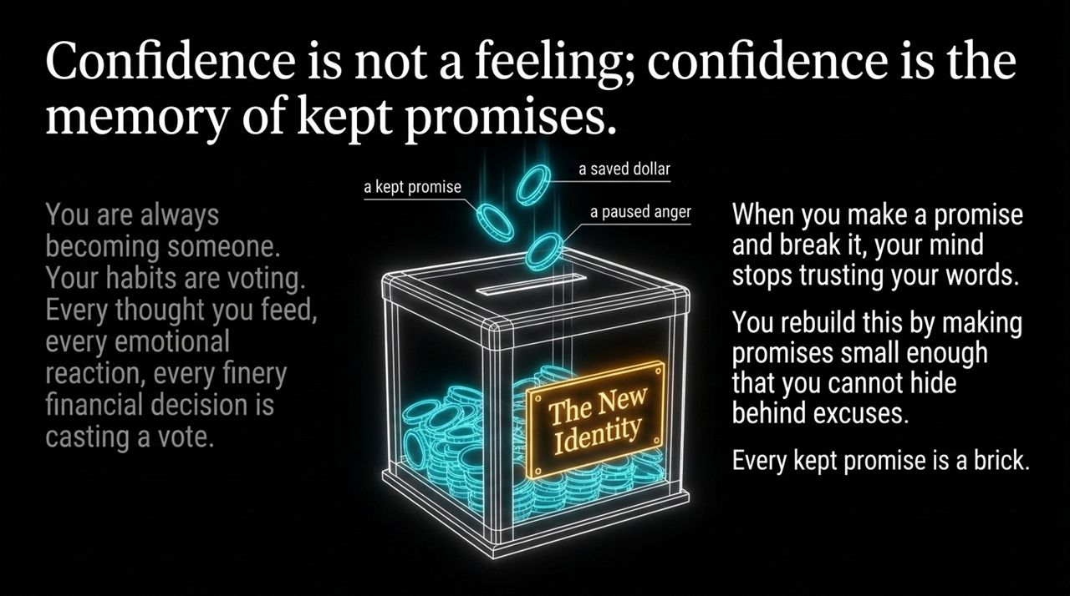
Notes:
Defining Confidence: Confidence is not a loud feeling or motivational hype; confidence is the memory of kept promises.
Casting Votes: Every time you keep a promise, pause in anger, or save a dollar, you drop a coin into the jar of your New Identity. You are perpetually voting for the person you are becoming.
Rebuilding Internal Trust: When you make promises to yourself and break them daily, your subconscious stops trusting your word. Rebuild self-trust by making promises so small and clear that you cannot hide behind excuses. Every kept promise acts as a brick in your new foundation.

Slide 12
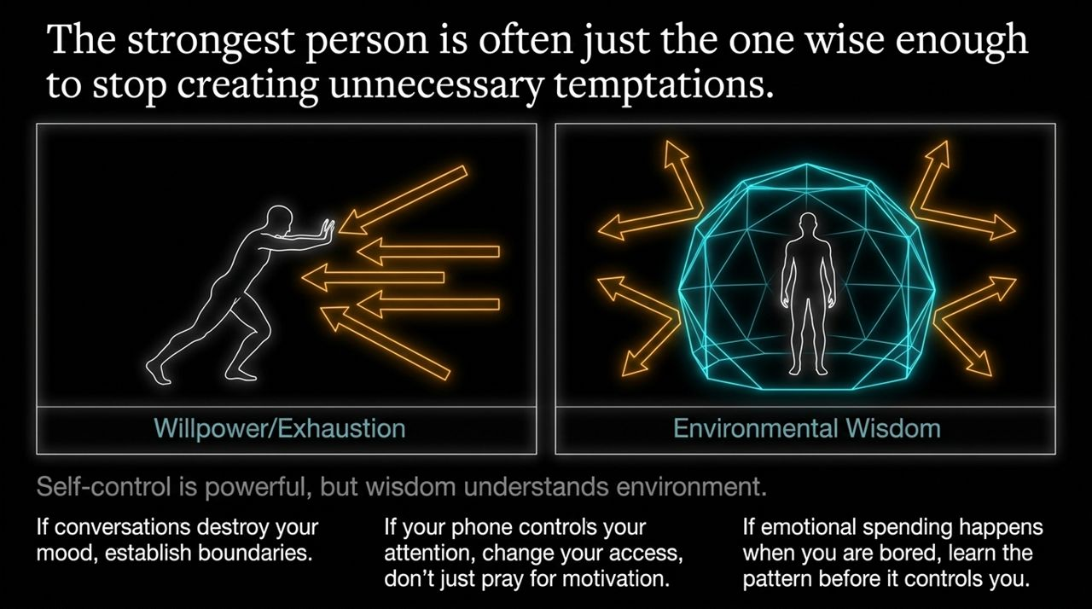
Notes:
Visual Contrast: Look at these two diagrams. On the left, a person uses raw willpower to push against endless incoming arrows—this leads straight to exhaustion. On the right, Environmental Wisdom creates a protective dome that deflects temptations before they reach you.
Practical Environmental Design:
If phone notifications destroy your focus, change your physical access instead of praying for motivation.
If toxic conversations ruin your mood, establish firm distance and boundaries.
If emotional spending occurs when you're bored, identify the pattern and remove the temptation ahead of time.

Slide 13
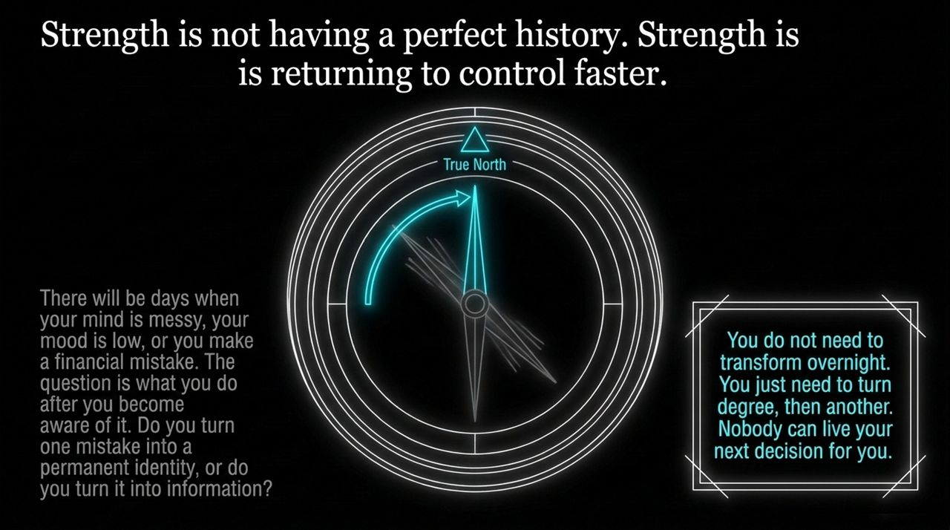
Notes:
Reframing Mistakes: Strength isn't about maintaining a spotless, perfect history. You will have messy days, low moods, and occasional financial slip-ups.
Information vs. Identity: The crucial question is: What do you do once you become aware of a mistake? Do you transform one bad moment into a permanent negative identity, or do you treat it as neutral information to adjust course?
One Degree Shift: Real strength means returning to center faster. You don't need an overnight miracle; you simply adjust your compass needle by one degree, and then another.

Slide 14
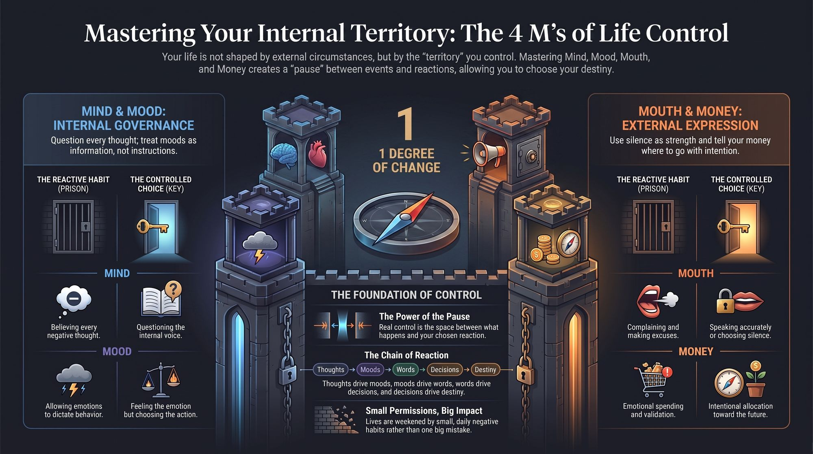
Notes:
Comprehensive Overview: To conclude our playbook, let's look at the full landscape of our internal territory:
Mind & Mood (Internal Governance): Shift from believing every negative thought to questioning your inner voice. Shift from letting emotions rule behavior to feeling the emotion while choosing intentional action.
Mouth & Money (External Expression): Shift from complaining and making excuses to accurate speech or purposeful silence. Shift from emotional spending to intentional allocation toward your future.
Final Key Takeaway: Your life is shaped by the territory you choose to govern. Nobody can make your next decision, think your next thought, or manage your next dollar for you. Take back control of your 4 M's starting today.

